Slide 1
Cryptocurrencies: Stylized Facts on a New Investible Instrument
Albert S. Hu Christine A. Parlour Uday Rajan
presented by：Zongpeng（Jobber）Shi

Slide 2
Outline
1. Introduction to Cryptocurrencies
2. ICO Returns
3. Secondary Market Returns
4. Thoughts about Pricing

Slide 3
Conclusions!
1. The ICO returns and secondary market returns are higher than S&P 500 returns and bear high volatility.
2. Cryptocurrencies secondary market returns are correlated with Bitcoins returns.

Slide 4
Introduction to Cryptocurrencies
Cryptocurrencies or tokens are digital assets issued in return for remuneration in the form of fiat money or other cryptocurrencies.
A coin has its own blockchain while a token operates on top of other underlying platforms.
Coins are used mainly as media of exchange or stores of value, akin to non-digital currencies. Tokens are typically used in a manner akin to coupons or vouchers on specific sites for specific purposes and are often used as a reward or funding mechanism.

Slide 5
ICO Returns
The median ICO raised about $6.4 million, but there is considerable skewness, with the mean being approximately equal to the 75th percentile, and the standard deviation about twice as high as the mean.

Slide 6
ICO Returns

Slide 7
ICO Returns

Slide 8
ICO Returns
Benchmarks?
IPO?
Are tokens securities?
Funds raised?
Time for issuance?
Vol/Return structure?
VC?
liquidity?
Return structure?

Slide 9
Secondary Market Returns

Slide 10
Secondary Market Returns

Slide 11
Secondary Market Returns

Slide 12
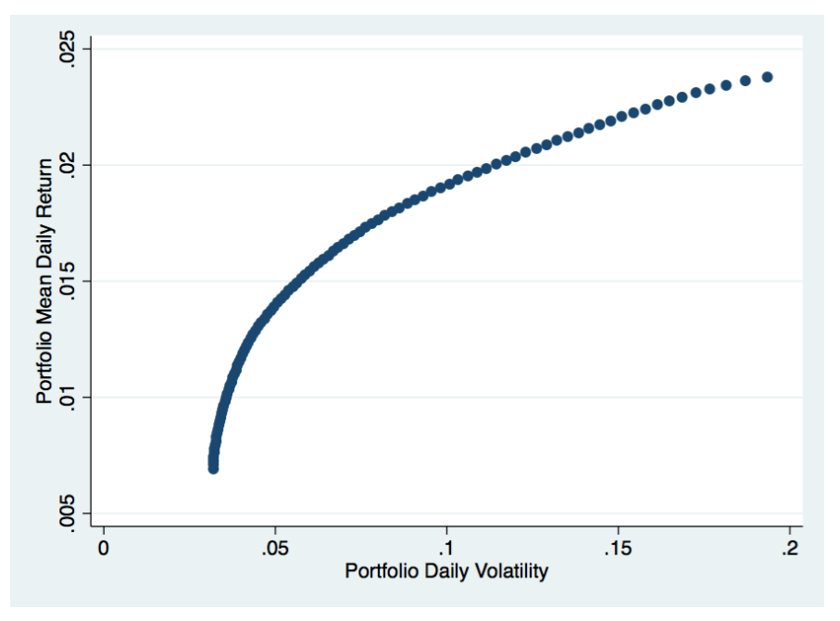
Secondary Market Returns
The minimum variance portfolio is 56% weighted in Bitcoin.
0.68%
3.22%

Slide 13
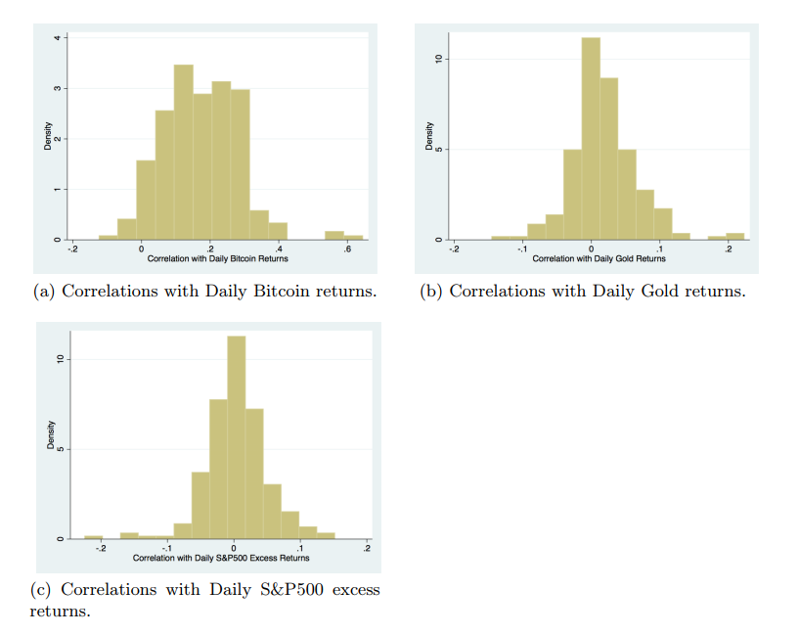
Secondary Market Returns

Slide 14
Secondary Market Returns

Slide 15
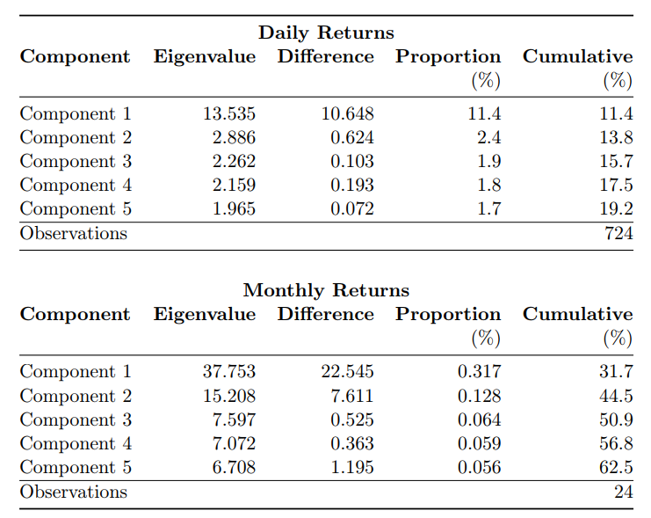
Secondary Market Returns
ρ=0.698
ρ=0.456

Slide 16
Thoughts about Pricing

Slide 17
Thoughts
1. Are tokens issued at steep discount?
1
2. Is the Bitcoin return the source of systematic risk?
2
3. What drives the market movement?
3

Slide 18
Thank You

